Slide 1
Citizen Police Review Board Discussion
February 11, 2019
U. Reneè Hall, Chief of Police
Dallas Police Department

Slide 2
21st Century Policing
The Dallas Police Department (DPD) has made prominent steps to transform the department to reflect 21st Century Policing, by facilitating integrity-driven policing that is focused on building trust, strengthening relationships, and community collaboration.
Public Safety Criminal Justice Committee

Slide 3
Purpose
In October 2017, Chief Hall began meeting with multiple community groups throughout the city of Dallas, who ultimately formed the Community Police Oversight Board Coalition.
Public Safety Criminal Justice Committee

Slide 4
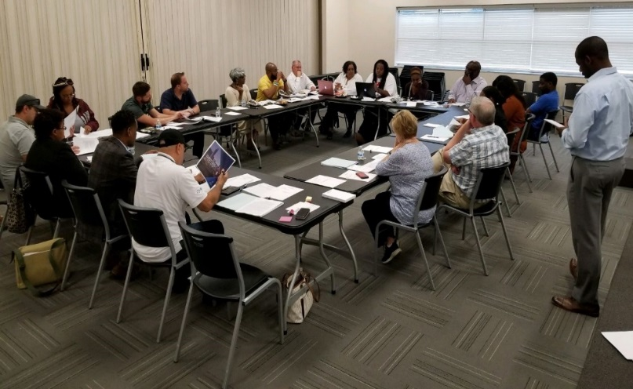
Community-Police Collaboration
Through this series of conversations, there was a demand to implement evidence-based and integrity driven best practices within the Police Department and oversight regarding the Citizen Review Board.
Public Safety Criminal Justice Committee

Slide 5
Areas of Focus
Complaint Process
Early Warning System
Restructure Citizen Police Review Board
Public Safety Criminal Justice Committee

Slide 6
Progress
Public Safety Criminal Justice Committee

Slide 7
Current Dallas Police Review Board
Founded in 1987, the current board consists of 15 members appointed by the Mayor and City Council
The Dallas City Code, Section 97-32 governs the functions, limitations and powers of the Citizen Police Review Board:
Accept signed written complaints from citizens on police procedures, treatment of citizens, abuse, harassment, violation of civil rights, injury, or fatality (referred to IAD)
Suggest further investigation
Conduct further investigation
Contract with independent investigation to assist and advise the board
Take sworn testimony
Request the city manager to review disciplinary action
Recommend improvement in DPD policy and procedures
Public Safety Criminal Justice Committee

Slide 8
Current Dallas Police Review Board
Currently, the Dallas Citizens Police Review Board only reviews a few cases a year
Subpoena powers of witnesses:
Requires a favorable vote of 7/15
Requires approval of ‘technical advisory committee’ or city council
May only subpoena witnesses, not suspect officer
Technical advisory committee
Advises board on law enforcement policies and procedures
Members have law enforcement experience, but are not from Dallas
Public Safety Criminal Justice Committee

Slide 9
Ideas to Restructure
Implement independent investigative arm
Policy implementation ability
Conduct external investigations of complaints a make recommendations for discipline
Establish subpoena power of officers
Establish a budget
Community engagement and outreach
Public Safety Criminal Justice Committee

Slide 10
City-wide Survey
1. Should the City of Dallas restructure the CPRB?
2. Should the CPRB be given the power to accept complaints directly from citizens and conduct administrative investigations on alleged policy violations by DPD officers?
3. Should the CPRB have subpoena power for DPD officers?
4. Should the CPRB make recommendations on discipline for policy violations to the Chief of Police?
5. Based on information received, do you have any additional recommendations?
Public Safety Criminal Justice Committee

Slide 11
Next Steps
February 11, 2019 – Public Safety Criminal Justice Committee
February/March 2019 – Council Briefing, Review and Action
Public Safety Criminal Justice Committee

Slide 12
Citizen Police Review Board Discussion
February 11, 2019
U. Reneè Hall, Chief of Police
Dallas Police Department

